Slide 1
Idea 1: Fukushima’s Fallout
Creative Brief: Stealth

Slide 2
Stealth
When the player chooses stealth over going loud, he or she is rewarded by having an easier time and conserving ammo
Stealth is a playstyle the players adopt to navigate to the player’s arbitrary objective without any conflict
In our game, Stealth will be achieved by making as little noise as possible (crouching / walking VS running) and using weapons that make less sound

Slide 3
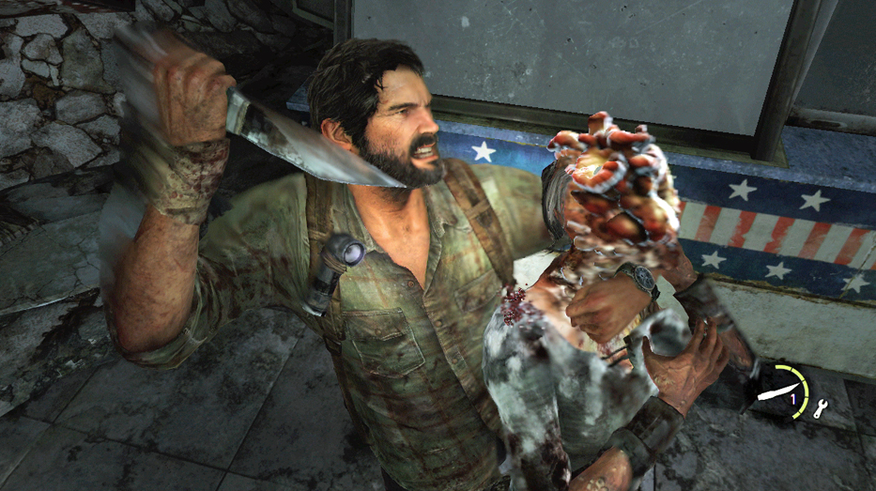
References (Videos / Images)

